Slide 1
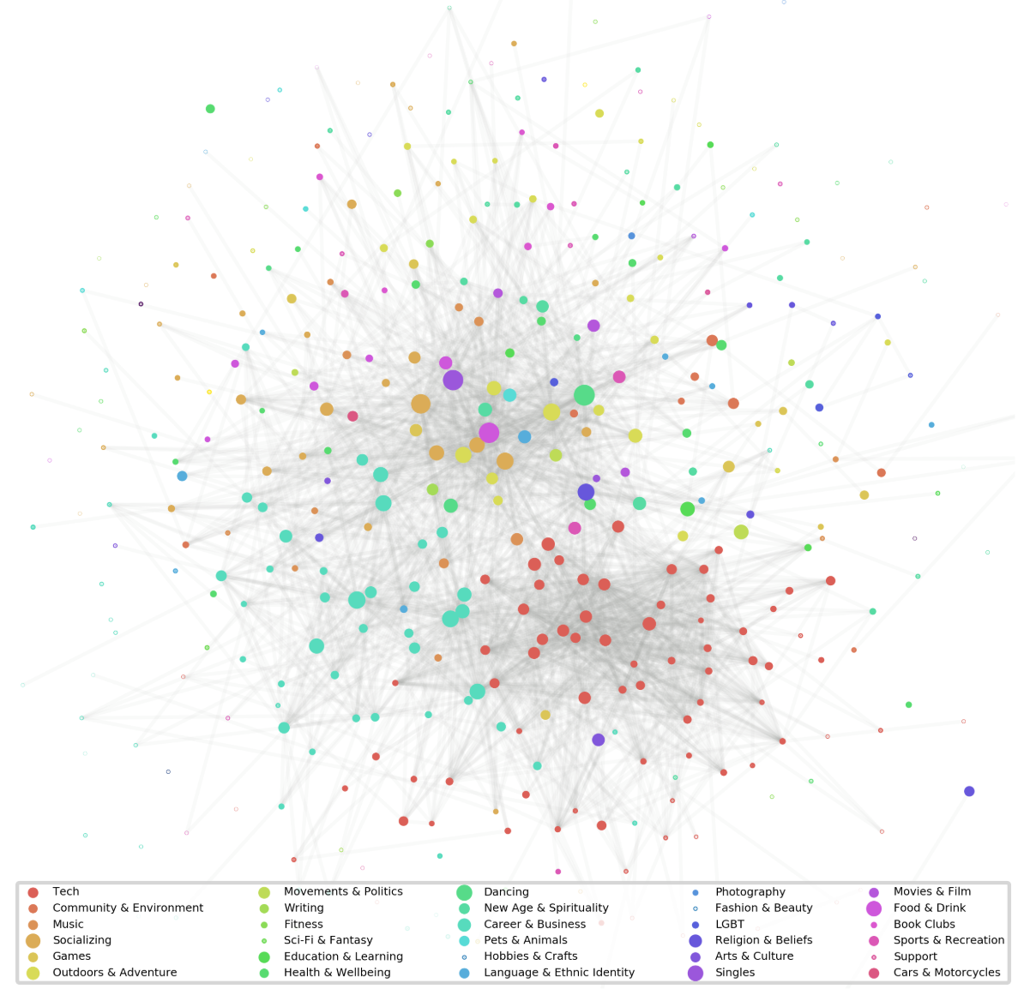
Nashville Meetup Social Networking Analysis
The Nashville Meetup dataset (11/16/2017), published by Stephen Bailey on the open source platform Kaggle, was used to identify “influencers” among more than1,400 members of the social networking website meetup.com by examining network metrics such as connectivity, degree, clustering, and centrality of each member based on social networking analysis.
The social network diagram on the left shows which types of Meetup communities are most popular in terms of two criteria.
Centrality – groups that have members drawn from all over the Nashville social scene
Clustering – groups that have a membership shared by many other groups.
Based on the social network diagram, Tech groups cluster together quite strongly, so do the Career & Business and Pets & Animals groups.
The Singles group is very interconnected as it is at the center of the graph and it crosses all boundaries – same as the Outdoors & Adventure and Socializing groups.
For the next step, I would recommend any interested business parties targeting “influencers” from above Meetup groups for advertising or marketing purposes.
Data Source: Bailey, Stephen. “Nashville Meetup Network.” Kaggle, 9 Feb. 2018, www.kaggle.com/stkbailey/nashville-meetup/data.

